Slide 1
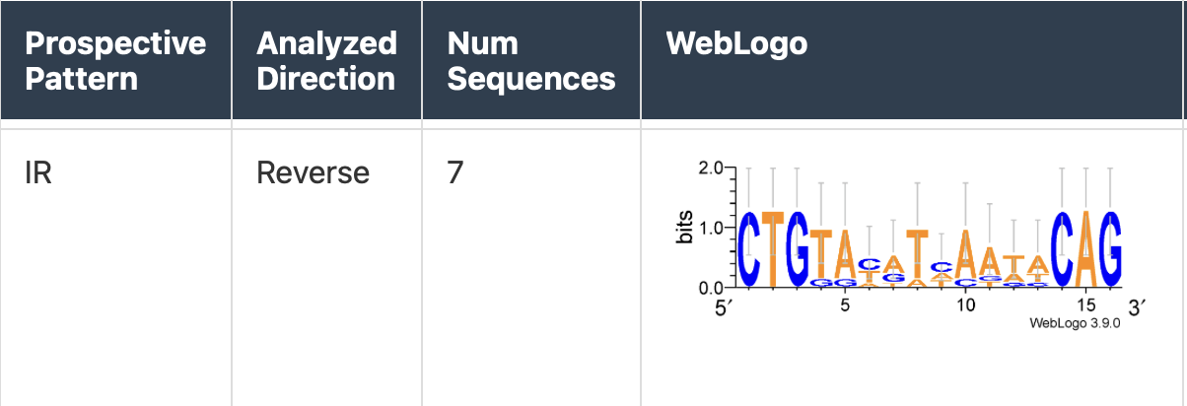
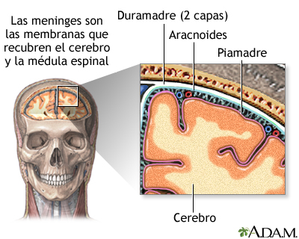
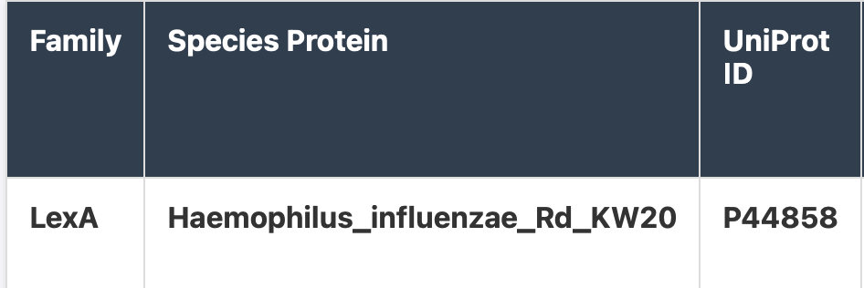
Preliminary Results
09 Jun 2026

Slide 2
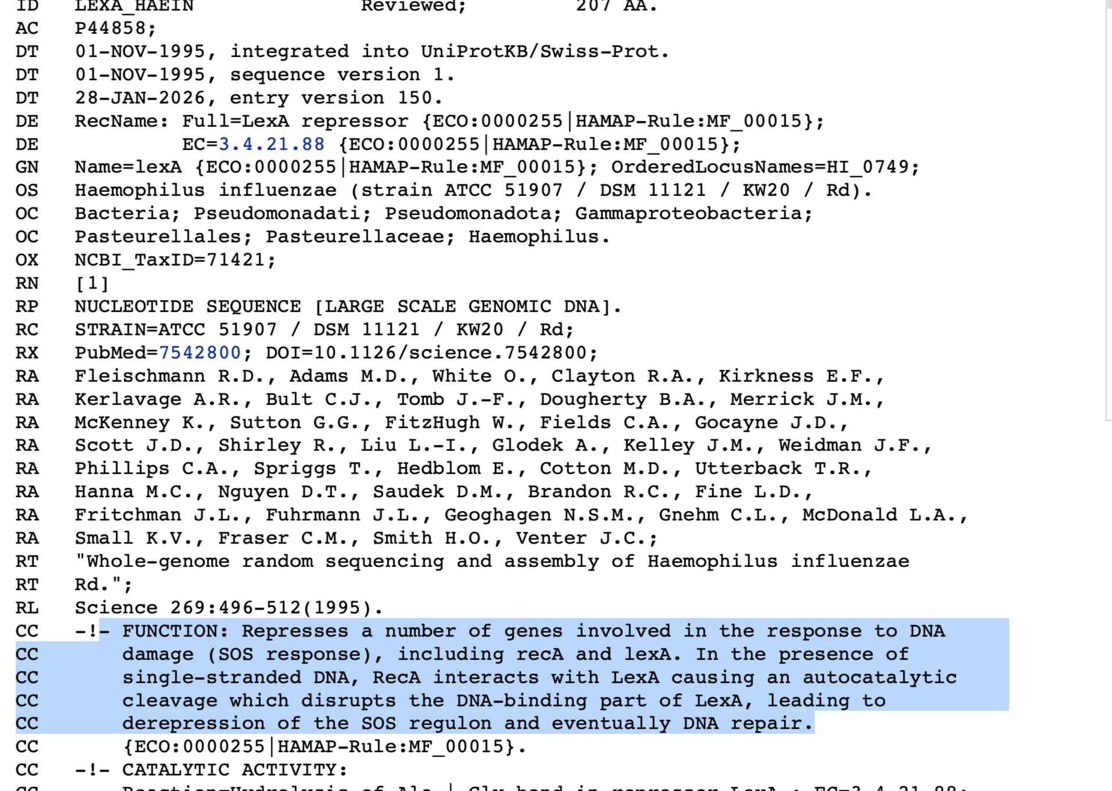

Slide 3
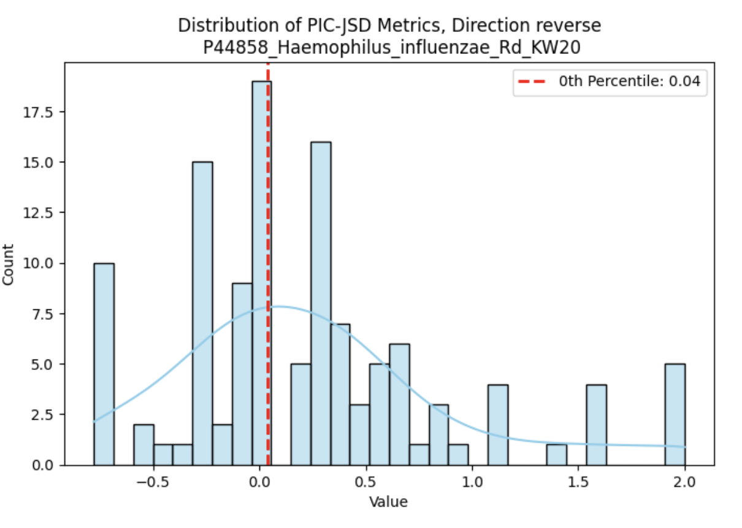
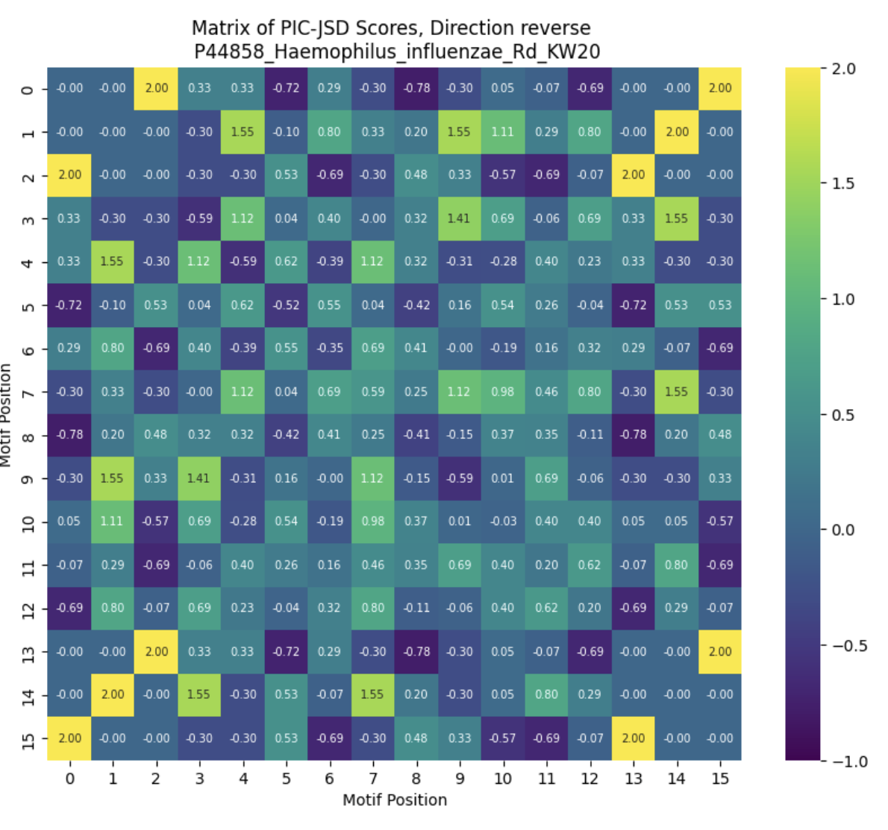

Slide 4
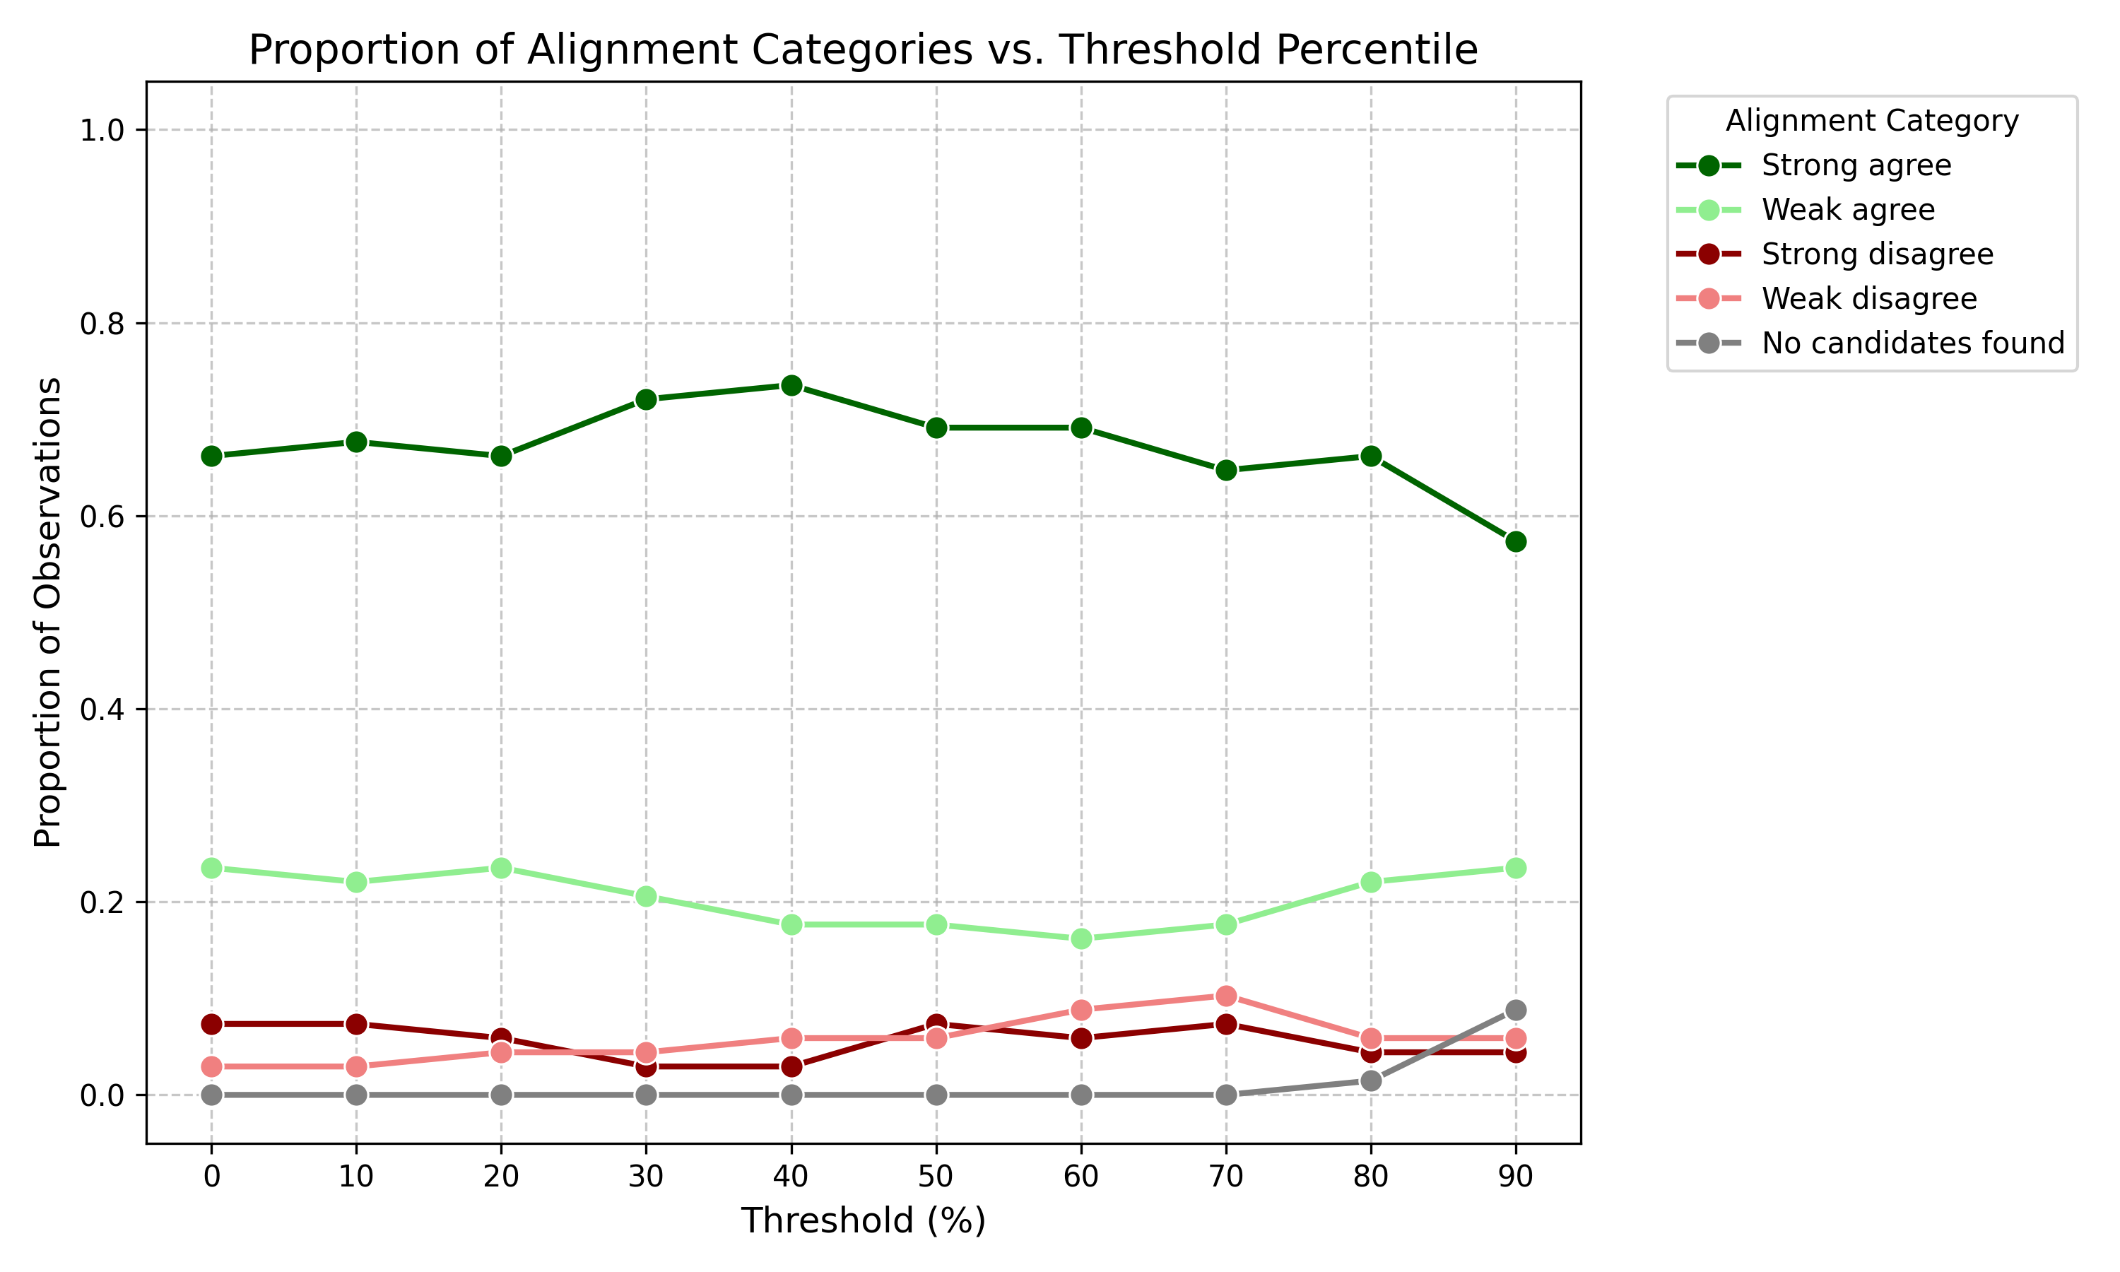

Slide 5
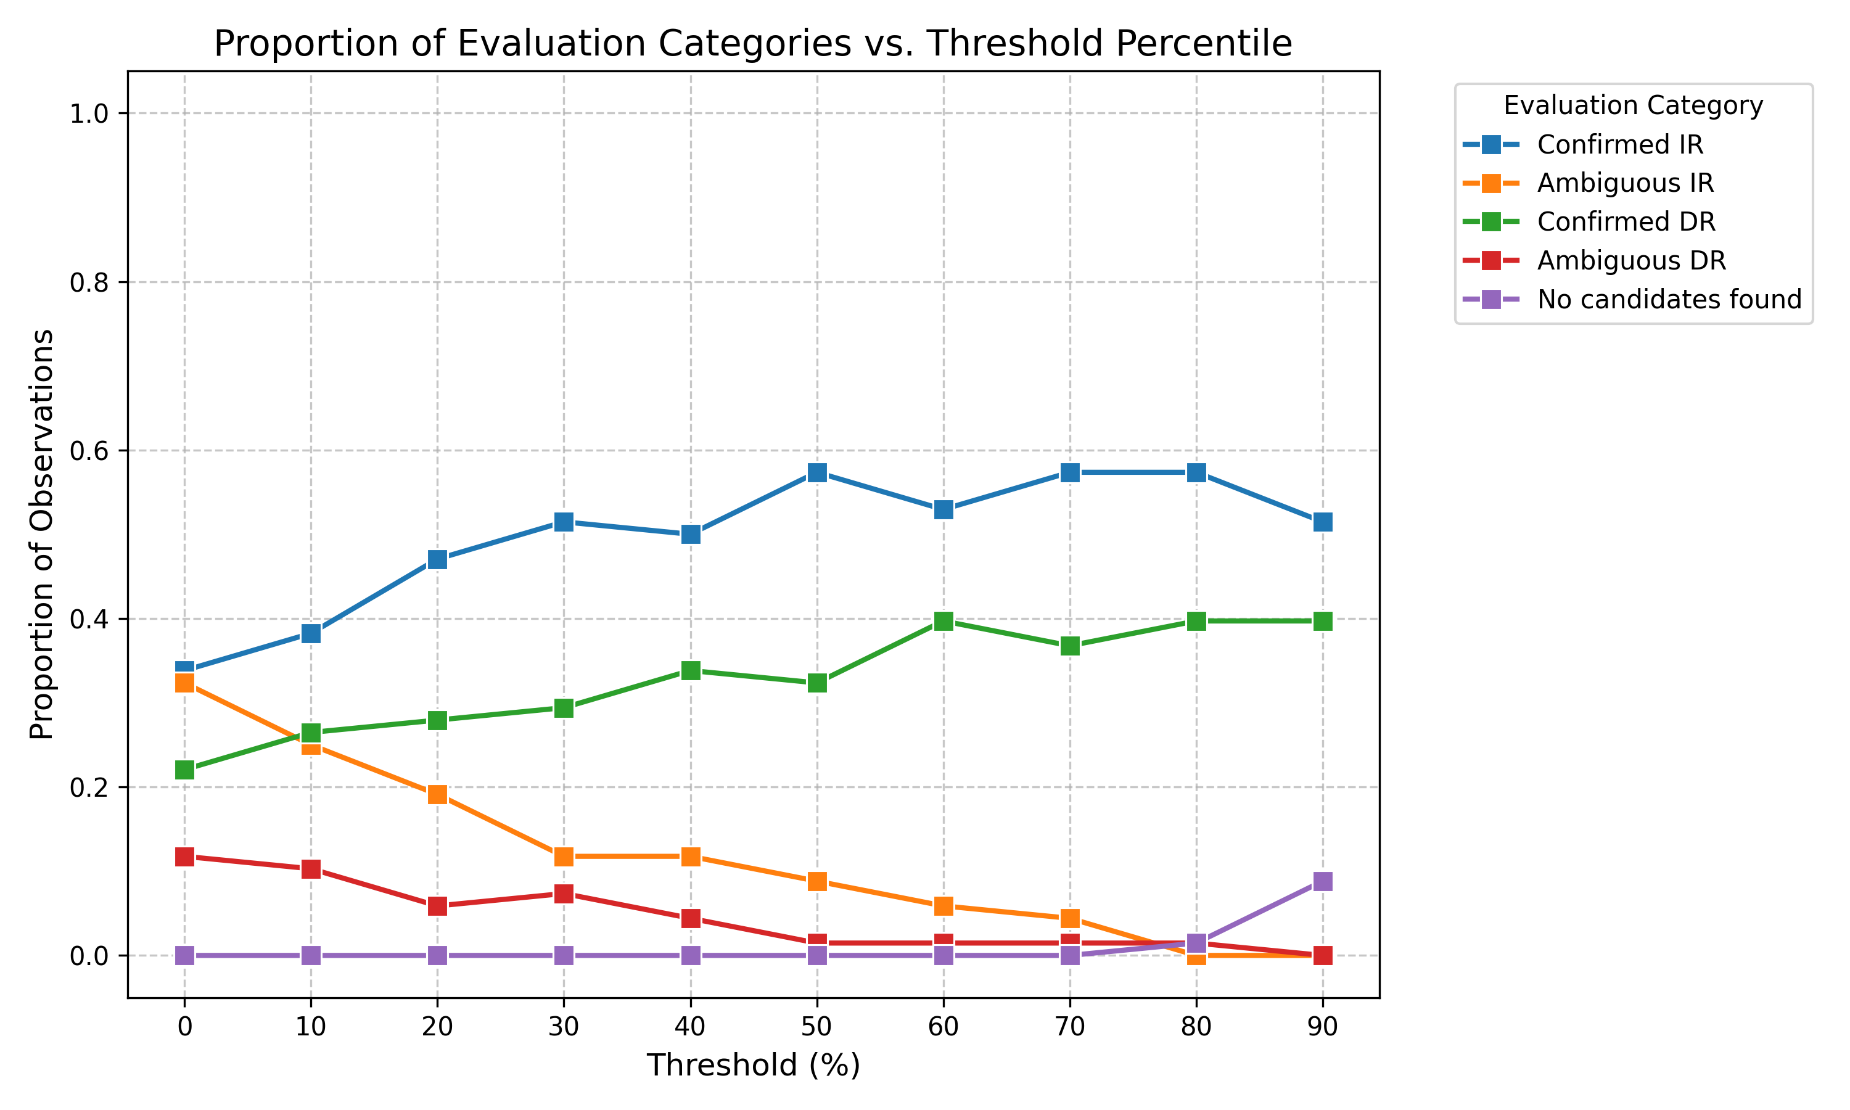

Slide 6

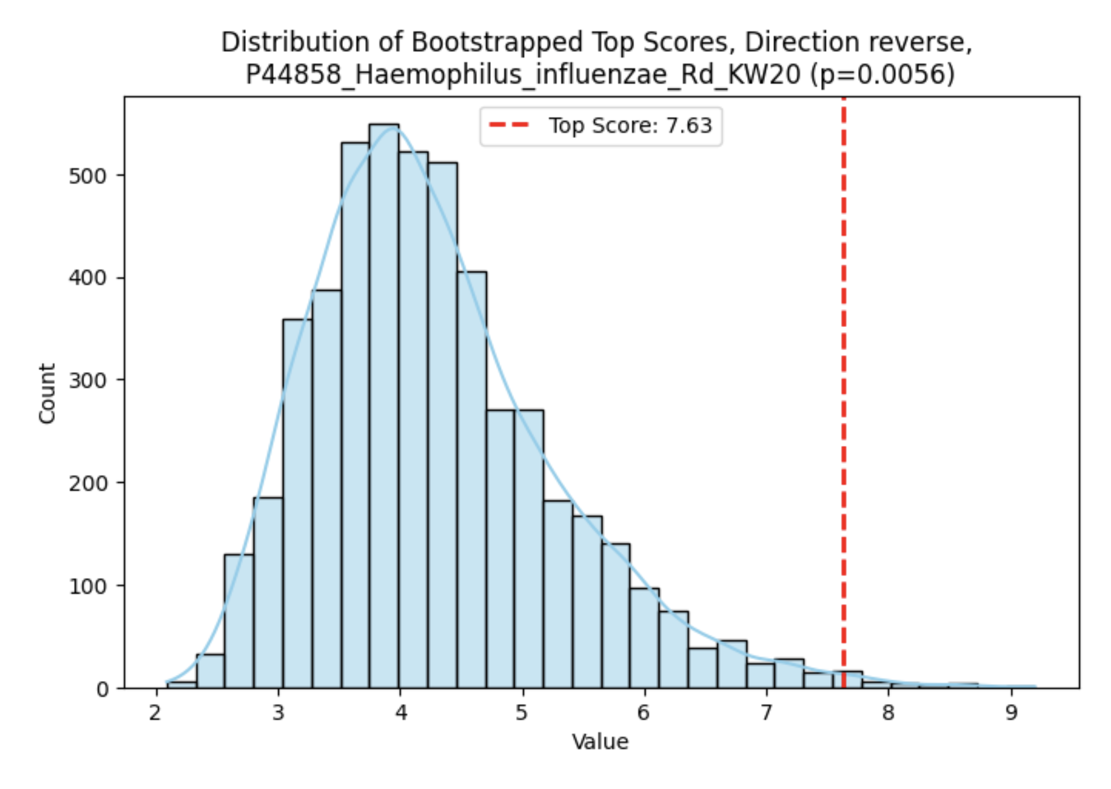
0% threshold
CTGTAC <> ATACAG

Slide 7

90% threshold
CTG <> CAG

Slide 8
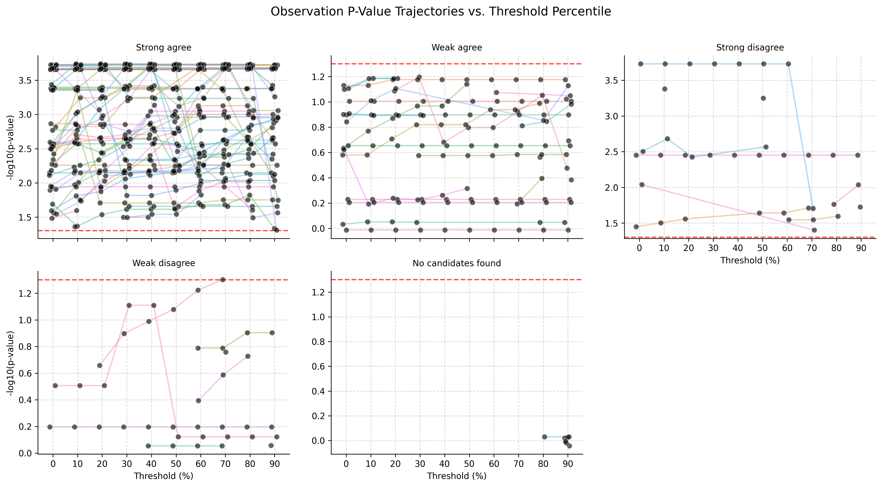

Slide 9
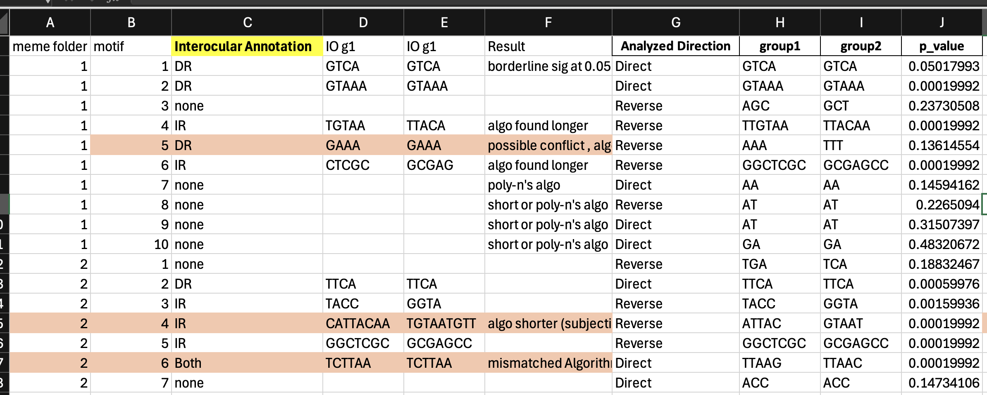
Next steps
MEME application – already done at 80%, check exceptions
User diagonal length spec – internal threshold decrement
It’s time to wrap it up – July 3rd submission
Work placement report – July 07
Defense July 13-17

